Slide 1

four suggestions for ways out of our impasse
identification and study of highly successful therapists’ methods and characteristics
routine outcome monitoring to encourage alerts and problem-solving if one is going off track
teaching & specific training in ‘facilitative interpersonal skills’
lessons from emerging research on how people develop excellence

Slide 2
ericsson & achieving excellence
Ericsson, K. A. (2015). "Acquisition and maintenance of medical expertise: a perspective from the expert-performance approach with deliberate practice." Acad Med 90(11): 1471-1486.
Hashimoto, D. A., et al. (2015). "Deliberate practice enhances quality of laparoscopic surgical performance in a randomized controlled trial: from arrested development to expert performance." Surg Endosc 29(11): 3154-3162.
Ericsson, K. A. (2013) “The science of excellence meets psychotherapy.” lecture at “Achieving clinical excellence conference” , May 17th, Amsterdam.
Ericsson, K. A., K. Nandagopal, et al. (2009). "Toward a science of exceptional achievement: Attaining superior performance through deliberate practice." Ann N Y Acad Sci 1172: 199-217.
Ericsson, K. A. (2008). "Deliberate practice and acquisition of expert performance: A general overview." Acad Emerg Med 15(11): 988-994.
Ericsson, K. A., J. t. Whyte, et al. (2007). "Expert performance in nursing: Reviewing research on expertise in nursing within the framework of the expert-performance approach.“ ANS Adv Nurs Sci 30(1): E58-71.
Ericsson, K. A., M. J. Prietula, et al. (2007). "The making of an expert." Harv Bus Rev 85(7-8): 114-121, 193.
Ericsson, K. A. (2007). "An expert-performance perspective of research on medical expertise: The study of clinical performance." Med Educ 41(12): 1124-1130.
Notes:
Benor in his 1990 survey states that a he identified 131 controlled trials of spiritual healing in English of which 56 showed statistically significant results at p<.01 or better and another 10 at p<.02-.05. The studies involved healing effects on enzymes, cells, yeasts, bacteria, plants, animals and man.
The study published in Holistic Medicine describes the fascinating work on anaesthetized mice which amongst other things showed a “linger effect”.

Slide 3
growing numbers of relevant books
K. A. Ericsson (ed.) (2009) “Development of professional expertise: Toward measurement of expert performance and design of optimal learning environ-ments.” Cambridge, England: Cambridge University Press.
K. A. Ericsson, et al. (ed) (2006). "The Cambridge handbook of expertise and expert performance.” Cambridge, England: Cambridge University Press.
K. A. Ericsson (ed.) (1996) “The road to excellence: The acquisition of expert performance in the arts and sciences, sports, and games.” New Jersey: Erlbaum
Lemov, D., Woolway, E. & Yezzi, K. (2012) “Practice perfect: 42 rules for getting better at getting better.” San Francisco: Jossey-Bass.
Ankerson, R. (2012) “The gold mine effect.” London: Icon Books.
Shenk, D. (2010) “The genius in all of us.” London: Icon Books.
Syed, M. (2010) “Bounce: The myth of talent and the power of practice.” London: Fourth Estate.
Coyle, D. (2009) “The talent code.” New York: Bantam.
Gladwell, M. (2008) “Outliers." Little, Brown and Company.
Colvin, G. (2008) “Talent is overrated: What really separates world-class performers from everybody else.” New York: Penguin.
Dweck, C. (2006) “Mindset: How you can fulfil your potential.” NY: Ballantine.
Syed, M. (2015) “Black box thinking: Marginal gains & secrets of high performance”
Notes:
Benor in his 1990 survey states that a he identified 131 controlled trials of spiritual healing in English of which 56 showed statistically significant results at p<.01 or better and another 10 at p<.02-.05. The studies involved healing effects on enzymes, cells, yeasts, bacteria, plants, animals and man.
The study published in Holistic Medicine describes the fascinating work on anaesthetized mice which amongst other things showed a “linger effect”.

Slide 4
true expertise & deliberate practice
“Traditionally, professional expertise has been judged by length of experience, reputation, and perceived mastery of knowledge and skill. Unfortunately, recent research demonstrates only a weak relationship between these indicators of expertise and actual, observed performance … Expert performance can, however, be traced to active engagement in deliberate practice (DP), where training (often designed and arranged by their teachers and coaches) is focused on improving particular tasks. DP also involves the provision of immediate feedback, time for problem-solving and evaluation, and opportunities for repeated performance to refine behavior.”
Ericsson, K. A. (2008). "Deliberate practice and acquisition of expert performance: A general overview." Acad Emerg Med 15(11): 988-994.

Slide 5
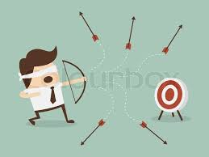
deliberate practice requires rapid feedback to refine performance
“Deliberate Practice also involves the provision of immediate feedback, time for problem-solving and evaluation, and opportunities for repeated performance to refine behavior.”

Slide 6
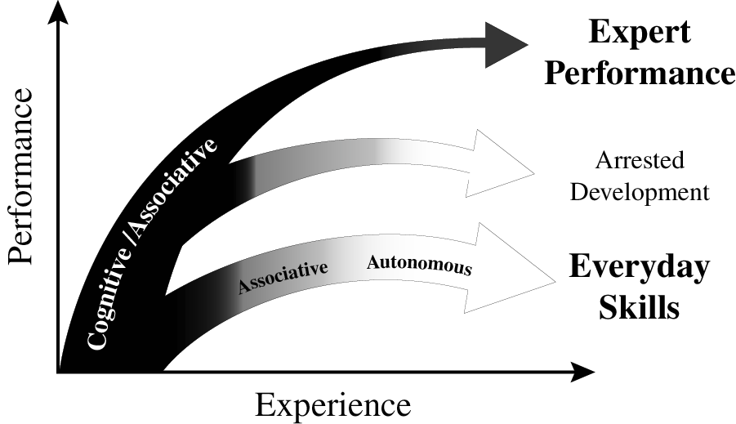
experience & variety of outcomes
Ericsson K. Anders. (2013). "The science of human excellence meets psychotherapy.” lecture at “Achieving clinical excellence conference.” May 17th, Amsterdam.

Slide 7
chess players/deliberate practice
it was time spent in “serious analysis of chess positions on one’s own” that was found to build expert performance (e.g. predicting key moves in games involving chess masters).
“active participation in chess tournaments” was unrelated to improvement, and “playing chess games outside chess tournaments” was a negative predictor of improvement.
the increased availability of chess computer programmes has been associated with a reduction in the time taken to become a grandmaster from about 10 years to 5 – 6 years.
there has also been the emergence of world class players from small countries (with little significant chess history) such as Norway (Magnus Carlsen).
Charness, N., et al. (1996). “The role of practice and coaching in entrepreneurial skill domains: An international comparison of life-span chess skill acquisition.” in K. A. Ericsson (ed.) “The road to excellence.” (51-80). Hillsdale, NJ: Lawrence Erlbaum.

Slide 8
chess players/deliberate practice
Charness, N., et al. (1996). “The role of practice and coaching in entrepreneurial skill domains: An international comparison of life-span chess skill acquisition.” in K. A. Ericsson (ed.) “The road to excellence.” (51-80). Hillsdale, NJ: Lawrence Erlbaum.

Slide 9

musicians & deliberate practice
classic early study on 20 yr old
violin students at the renowned
Music Academy of West Berlin
painstaking series of interviews
students sorted into 3 groups by professors’ assessments and success in open competitions
groups indistinguishable by average age of starting violin (age 8), average age at which decided to become musicians (just before age 15), number of teachers, etc. etc.
what stood out dramatically were the differences in hours spent practising – with no exceptions!
Ericsson, K. A., Krampe, R. T. & Tesch-Romer, C. (1993). “The role of deliberate practice in the acquisition of expert performance." Psychol Review 100(3): 363-406.

Slide 10
maintaining expertise
"If I don't practice one day, I know it; two days, the critics know it; three days, the public knows it.“ Jascha Heifetz
Krampe, R. T. and K. A. Ericsson (1996). "Maintaining excellence: Deliberate practice and elite performance in young and older pianists." J Exp Psychol Gen 125(4): 331-359. Two studies investigated the role of deliberate practice in the maintenance of cognitive-motor skills in expert and accomplished amateur pianists. Older expert and amateur pianists showed the normal pattern of large age-related reductions in standard measures of general processing speed. Performance on music-related tasks showed similar age-graded decline for amateur pianists but not for expert pianists, whose average performance level was only slightly below that of young expert pianists. The degree of maintenance of relevant pianistic skills for older expert pianists was predicted by the amount of deliberate practice during later adulthood. The role of delib-erate practice in the active maintenance of superior domain-specific performance in spite of general age-related decline is discussed.

Slide 11
experience & variety of outcomes
Ericsson K. Anders. (2013). "The science of human excellence meets psychotherapy.” lecture at “Achieving clinical excellence conference.” May 17th, Amsterdam.

Slide 12
psychotherapy/deliberate practice
17 therapists & 1,632 clients were studied – therapists were classified into four quartiles depending on their effectiveness.
as expected – qualifications, profession, experience, age, and gender were found to be unrelated to effectiveness.
fascinatingly, when asked about their use of client feedback, more successful therapists were much more likely to report being “surprised” by it – possibly a measure both of how well they had “set up” the feedback & of their openness/receptivity
also significant was their answer to the question: “How many hours per week (on average) do you spend alone seriously engaging in activities related to improving your therapy skills in the current year?” – the quartiles answered on average 7.39 (1st quartile); 4.13 (2nd); 2.00 (3rd) & 0.50 hours (4th quartile).
Chow, D. L., et al. (2015). "The role of deliberate practice in the development of highly effective psychotherapists." Psychotherapy (Chic) 52(3): 337-345.

Slide 13
psychotherapy/deliberate practice
“solitary activities” included ”reviewing therapy recordings alone, reviewing difficult/challenging cases alone, mentally running through & reflecting on past sessions in one’s mind, mentally running through & reflecting on what to do in future sessions, writing down reflections of past sessions, writing down plans for future sessions, viewing master therapist videos with the aim of developing specific therapeutic skills as a therapist, reading case examples (e.g. narratives, transcripts, case studies), reading of journals pertaining to psychotherapy & counselling, reading/re-reading of core counselling & therapeutic skills in psychotherapy.”
Chow, D. L., et al. (2015). "The role of deliberate practice in the development of highly effective psychotherapists." Psychotherapy (Chic) 52(3): 337-345.

Slide 14
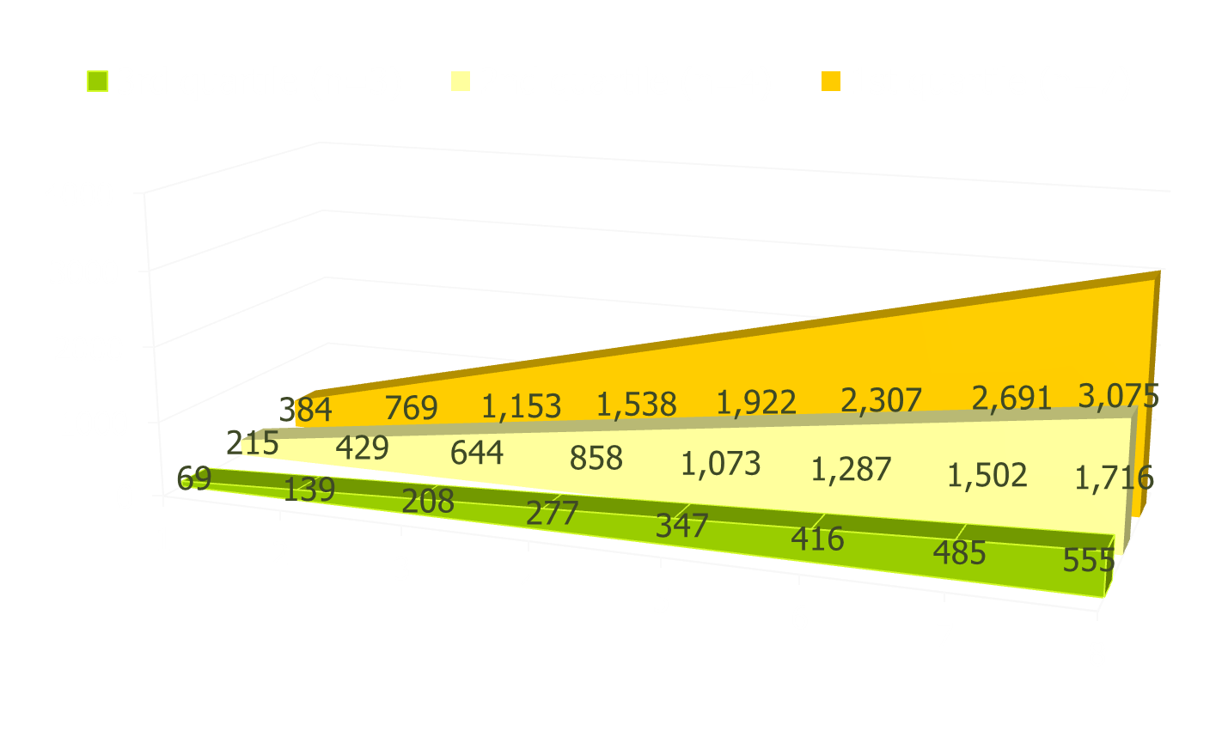
psychotherapy/deliberate practice
cumulative time spent in solitary practice over the first eight years of work as a psychotherapist

Slide 15
design & sequencing of training
ideally one monitors current performance & then designs specific individualized training activities: there is relevance here both for psychotherapists & clients.
Ericsson K. Anders. (2013). "The science of human excellence meets psychotherapy.” lecture at “Achieving clinical excellence conference.” May 17th, Amsterdam.

Slide 16
designing optimal level of practice
Ericsson K. Anders. (2013). "The science of human excellence meets psychotherapy.” lecture at “Achieving clinical excellence conference.” May 17th, Amsterdam.

Slide 17
developing expertise research
clarify overall starting point and overall goal – an obvious example is an aim to improve the proportion of clients who get to “recovery”.
choose an important sub-goal that will be a good building block in reaching the overall goal.
again clarify one’s starting point and what the targeted sub-goal end state will look like.
deliberate practice of sub-goal building block
fast, accurate feedback, the challenge repeated many times, gradual incremental progress
select further building block sub-goals to work on
monitor progress to main over-arching goal
… badminton example!

Slide 18
where should therapists focus?
common factors quality relationship, good goal agreement, confidence in methods
specific factors appropriate evidence based therapy, skilfully executed & supervised
Both camps can potentially make considerable gains in the results they achieve through better understanding and application of research on how individuals develop expertise – careful, measured assessment of one’s base-line; identification of key areas to work on; clarity about what better performance will look like; repeated, focused practice with rapid feedback; monitoring of whether performance improves & skilled supervision/mentoring

