Slide 1
session 8 – key points
‘nourishing’ relationships: ‘knowledge’ & ‘intelligence’
touch and sex
conflict and wisdom
‘attachment’ and other innate behavioural systems
continuing to work with overall social networks & the affect dyad exercise

Slide 2
the six ‘rules’ of friendship
stand up for them when they’re absent
share important news with each other
trust and confide in each other
volunteer help when it would be useful
provide emotional support for each other
try to make each other happy
the six rules were derived from 4 studies involving British, Italian, Hong Kong and Japanese participants
Argyle, M. & M. Henderson (1984). "The rules of friendship." Journal of Social and Personal Relationships 1(2): 211-237.

Slide 3
knowledge/interest seems crucial
know their hopes & dreams
know how to have a fun time with them
regularly ask about their tastes, preferences & passions
listen & remember when they tell me about their problems
remember their birthday and other special days
know all about their family

Slide 4
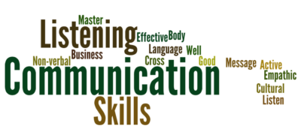
helpful communication central too
comfortable talking about my feelings
frequently encourage to express their views
always try to be honest
often ask for feedback
know how to describe my feelings accurately
praise & encourage far more often than criticize
try to make time for friendly conversation

Slide 5
interesting recent touch research
Triscoli, C., et al. (2019). "Depression predicts interpersonal problems partially through the attitude towards social touch." Journal of Affective Disorders 246: 234-240.
Sekerdej, M., et al. (2018). "Keeping in touch with context: Non-verbal behavior as a manifestation of communality and dominance." Journal of Nonverbal Behavior 42(3): 311-326.
Jakubiak, B. K. and B. C. Feeney (2017). "Affectionate touch to promote relational, psychological, and physical well-being in adulthood: A theoretical model and review of the research." Personality and Social Psychology Review 21(3): 228-252.
Nummenmaa, L., et al. (2016). "Social touch modulates endogenous mu-opioid system activity in humans." Neuroimage.
Jakubiak, B. K. and B. C. Feeney (2016). "A sense of security: touch promotes state attachment security." Social Psychological and Personality Science 7(7): 745-753.
Jakubiak, B. K. and B. C. Feeney (2016). "Keep in touch: The effects of imagined touch support on stress and exploration." Journal of Experimental Social Psychology.
Suvilehto, J. T., et al. (2015). "Topography of social touching depends on emotional bonds between humans." Proceedings of the National Academy of Sciences.
Robinson, K. J., et al. (2015). "When in doubt, reach out: touch Is a covert but effective mode of soliciting and providing social support." Social Psychological and Personality Science 6(7): 831-839.
Cohen, S., et al. (2015). "Does hugging provide stress-buffering social support? A study of susceptibility to upper respiratory infection and illness." Psychological Science 26(2): 135-147.

Slide 6
friendship & conflict
540 participants (only 112 were male)
all adults - 70% were aged between 18 & 38
363 were currently in a couple relationship
asked about ‘severe fallings out’ with people in their social network
last week/month/year
40% still not reconciled a year afterwards
conflicts with those who matter most to us in our personal social networks are surprisingly common
Dunbar, R. & A. Machin (2014). "Sex differences in relationship conflict and reconciliation." Journal of Evolutionary Psychology 12(2-4): 109-133.

Slide 7
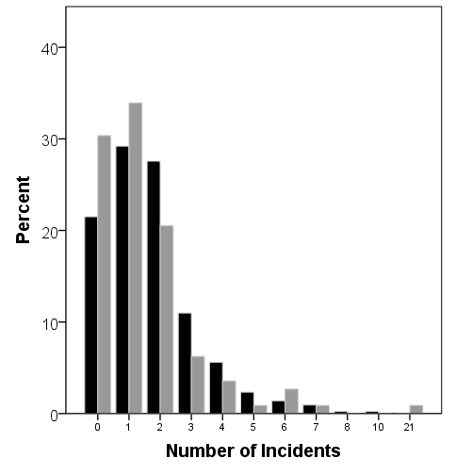
frequency of ‘severe falling out’
women: black columns
men: grey
columns
average of 1.67 episodes per person, but a high proportion were recent suggesting an underestimate for last year
Dunbar & Machin, 2014

Slide 8
situated wise reasoning scale
mountain: - 5, 15, 50, 150 -
food: well balanced ‘diet’
garden: regular ‘watering’
music: how play together
attachment mentalising memory
mu-opioids orbital pfc capacity

Slide 9
attachment: care-seeking situations

Slide 10
other ‘intrinsic’ behavioural systems
care-seeking
care-giving
exploration
sex
power
about right?
too hot?
too cold?

Slide 11
affinity groups & active networks
on average there are about 150 people in a personal full ‘active network’ – with a natural range of approximately 100-250; it correlates with pre-industrial village size & earlier tribal size; the active network may well serve both territorial & mate-access functions
one’s full ‘active network’ is made up mostly of ‘acquaintances’ - all the people with whom one has a ‘personalized’ relationship and who one wants to maintain contact with
successive network layers increase in numbers by a factor of about 3, and tend to involve relationships that demand less time investment to maintain & that are less emotionally close – however different layers respond to different needs
the smaller – approximately 50 sized – affinity or foraging group probably primarily has an anti-predation function
10 =
intensely close/intimate
social identity theory (haslam, cruwys, et al) highlights the considerable health gains obtainable through identification & participation with a variety of groups, that may be populated by acquaintances rather than friends
0 =
emotionally neutral

Slide 12
session 8 – key points
‘nourishing’ relationships: ‘knowledge’ & ‘intelligence’
touch and sex
conflict and wisdom
‘attachment’ and other innate behavioural systems
continuing to work with overall social networks & the affect dyad exercise

